Slide 1
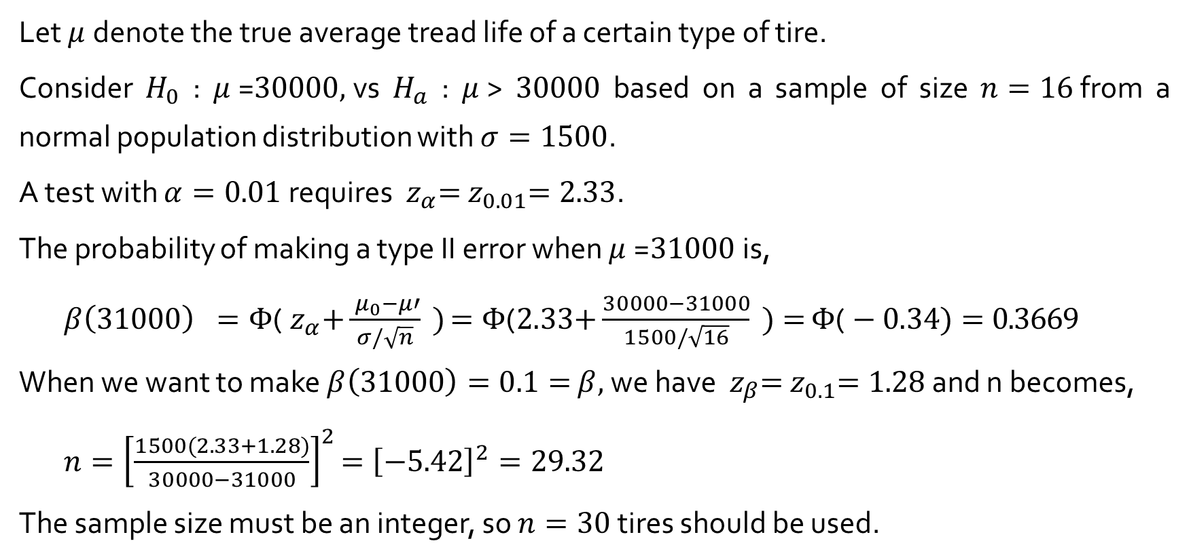
Example 8.7
Let $μ$denote the true average tread life of a certain type of tire.
Consider $H_{0}$ : $μ$=$30000,$vs $H_{a}$ : $μ$> $30000$ based on a sample of size $n=16$from a normal population distribution with $σ=1500$.
A test with $α=0.01$requires ${ z}_{α}={ z}_{0.01}=2.33$.
The probability of making a type II error when $μ$=$31000$is,
$β\left(31000\right) =Φ\text{(}{ z}_{α}\text{+}\frac{{ μ}_{0}−μ′}{σ/\sqrt{n}} )$ $=Φ\text{(}2.33\text{+}\frac{30000−31000}{1500/\sqrt{16}} )=$ $Φ\text{(}−0.34)=0.3669$
When we want to make $β\left(31000\right)=0.1=$ $β,$we have ${ z}_{β}={ z}_{0.1}=1.28$ and n becomes,
$n={\left[\frac{1500(2.33+1.28)}{30000−31000}\right]}^{2}$ $={\left[−5.42\right]}^{2}=29.32$
The sample size must be an integer, so $n=30$tires should be used.

Slide 2
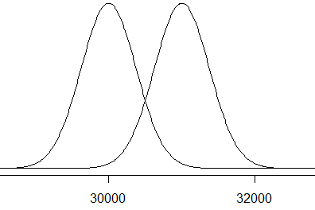

Example 8.7
$H_{0}$ : $μ$=$30000,$vs $H_{a}$ : $μ$> $30000$
Rejection region :
$Z=\frac{\overline{X}−{ μ}_{0}}{σ/\sqrt{n}}=\frac{\overline{X}−30000}{1500/\sqrt{16}}>2.33={ z}_{0.01}→\overline{X}>$ $30000+$ $2.33×\frac{1500}{\sqrt{16}}=30873.75$
Type II error probability when $μ=$ $31000$
P($\overline{X}<30873.75$ when $μ=31000)=P\left(\frac{\overline{X}−31000}{\frac{1500}{\sqrt{16}}}<\frac{30873.75−31000}{\frac{1500}{\sqrt{16}}}\right)$
$=P\left(Z<−0.3366\right)=0.3682$
30873.75

Slide 3
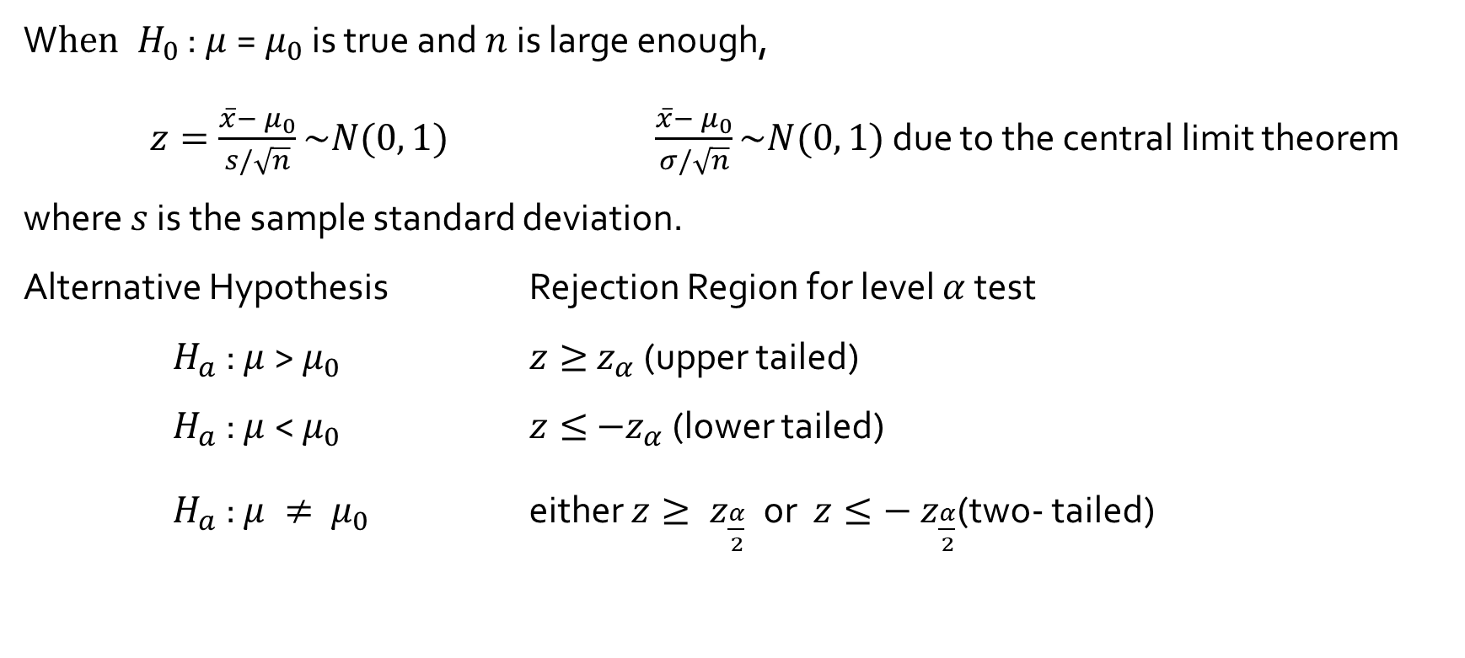
Test about a population mean with unknown $σ$ and Large Sample
W$hen H_{0}$ : $μ$=${ μ}_{0}$ is true and $n$is large enough,
$z=\frac{\overline{x}−{ μ}_{0}}{s/\sqrt{n}}\sim N(0, 1)$ $\frac{\overline{x}−{ μ}_{0}}{σ/\sqrt{n}}\sim N(0, 1)$ due to the central limit theorem
where $s$ is the sample standard deviation.
Alternative Hypothesis Rejection Region for level $α$ test
$H_{a}$ : $μ$> $μ_{0}$ $z≥{ z}_{α}$ (upper tailed)
$H_{a}$ : $μ$< $μ_{0}$ $z≤{ −z}_{α}$ (lower tailed)
$H_{a}$ : $μ ≠ { μ}_{0}$ either $z≥{ z}_{\frac{α}{2}} \text{or}$ $z≤{− z}_{\frac{α}{2}}$(two- tailed)

Slide 4
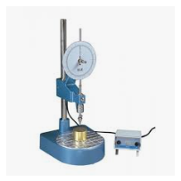
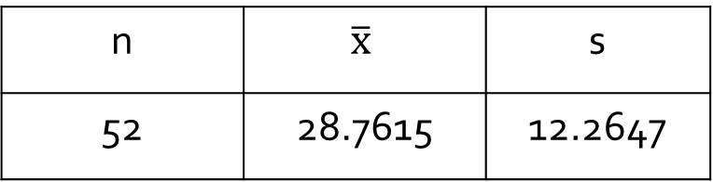

Example 8.8
A dynamic cone penetrometer(DCP) is used for measuring material resistance to penetration.
It is required that true average DCP value for a certain type of pavement be less than 30. (use $α=0.05)$
Is the true average DCP value for a certain type
of pavement be less than 30?
n | $$\overline{x}$$ | s
52 | 28.7615 | 12.2647

Slide 5

Example 8.8
$μ$ : true average DCP value
$H_{0}$ : $μ$= 30 versus $H_{a}$ : $μ<$30
$z=\frac{\overline{x}−30}{s/\sqrt{n}}$
$H_{0} \text{i}s rejected if z≤{− z}_{0.05}=−$1.645.
With n = 52, $\overline{x}=$ 28.76, $and s=$ 12.2647.
$z=\frac{28.76−30}{12.2647/\sqrt{52}}=−0.73$
Since $−$0.73 > $−$1.645, $H_{0}$ cannot be rejected.

